Slide 1

Predicting Throughput with Recurrent Neural Networks
Everett Tucker
First-Year Computer Science Major, Statistics Minor

Slide 2
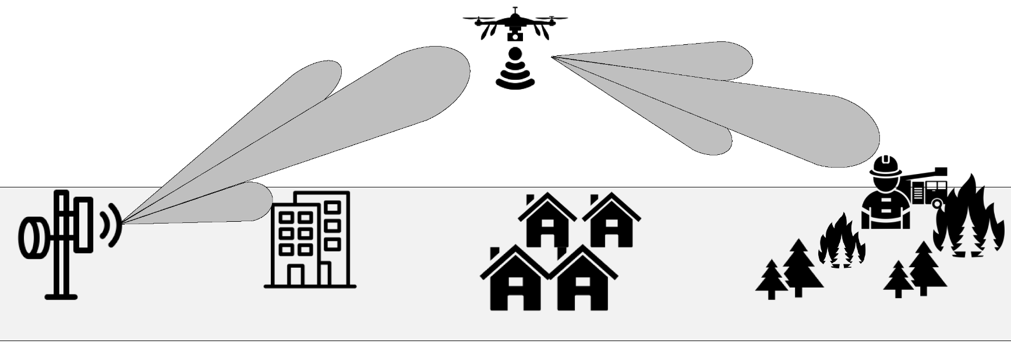
Problem Statement
This predictive model is part of a larger research project into communications optimization.
UAV Reinforcement Learning for Urban Communication Maximization
Predicting Throughput with RNNs
Improves Value Function Realisticness

Slide 3
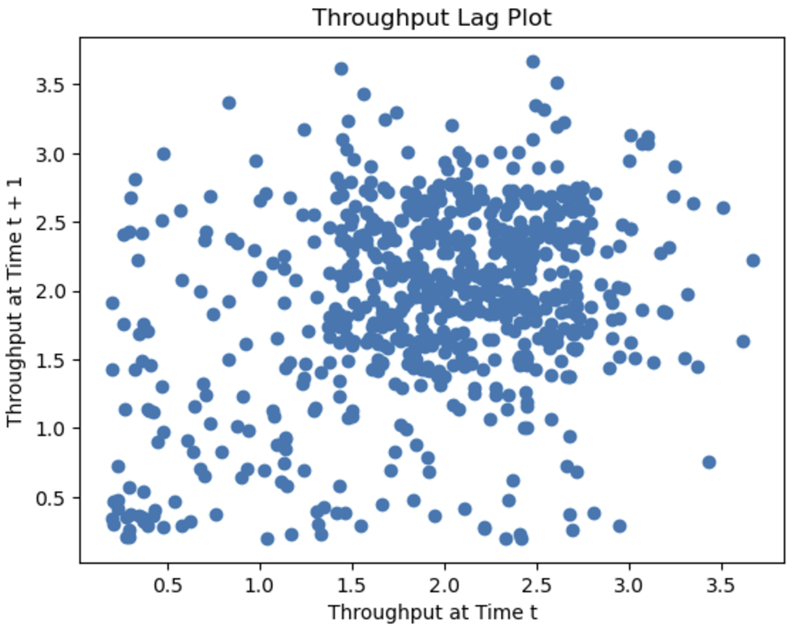
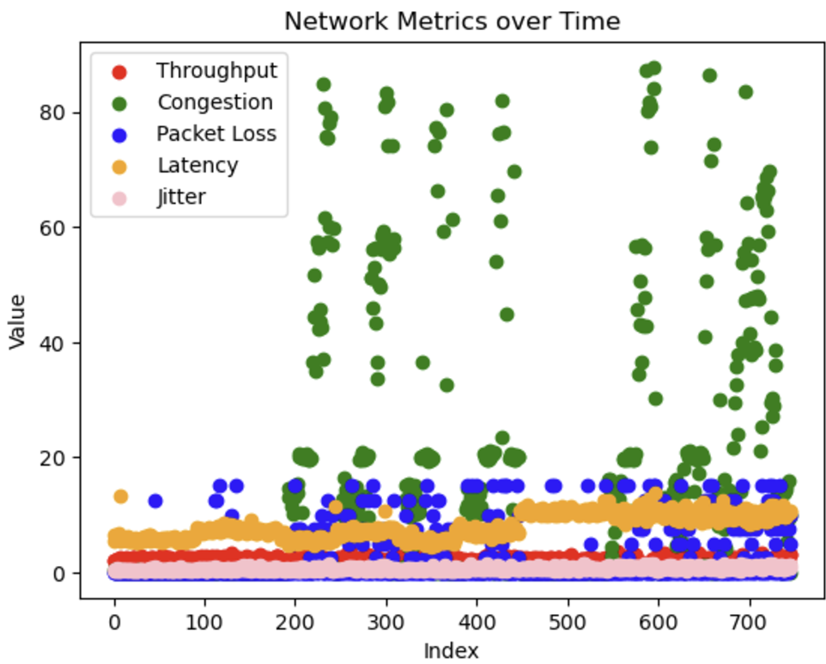
Importing and Visualizing Data
Used the “Network Anomaly Dataset” from Kaggle
Dataset contains multiple timestamped communication metrics
Visualized data using lag plots and graphs over time

Slide 4
Data Preprocessing
Prune Anomaly Points
Normalize
Split into Buffer Chunks
Extract Desired Features
Principal Component Analysis
Divide into Training, Validation, and Test Sets

Slide 5

Constructing the Model
Constant Smoothing Convolution
Initial Hidden Data
Output Data
Linear Node +
ReLu
Linear Node +
ReLu
Output Linear Node
Data Chunk
0 | 1 | … | k - 1

Slide 6
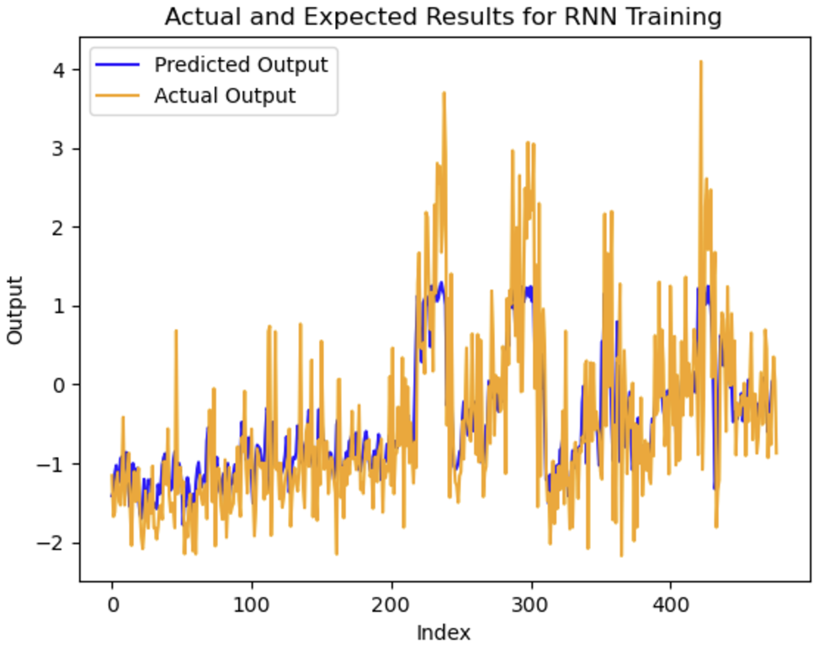
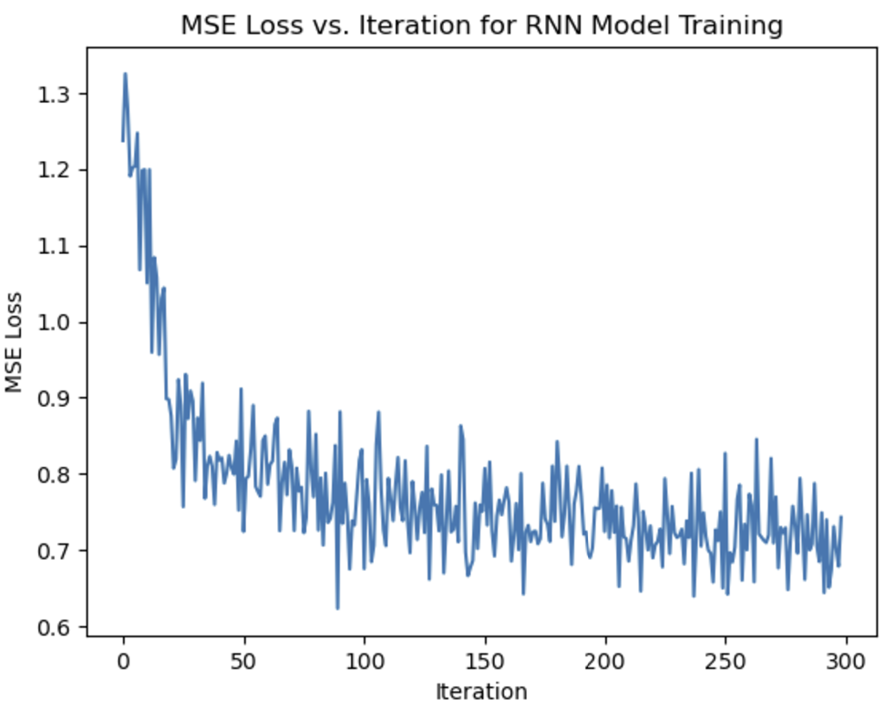
Model Training
Hyperparameter Tuning Results:
k (buffer size): 3
learning rate: 0.0001
Activation: ReLu
Loss: Mean Squared Error
Num components (PCA): 3
l (convolution size): 6
iterations: 300,000

Slide 7
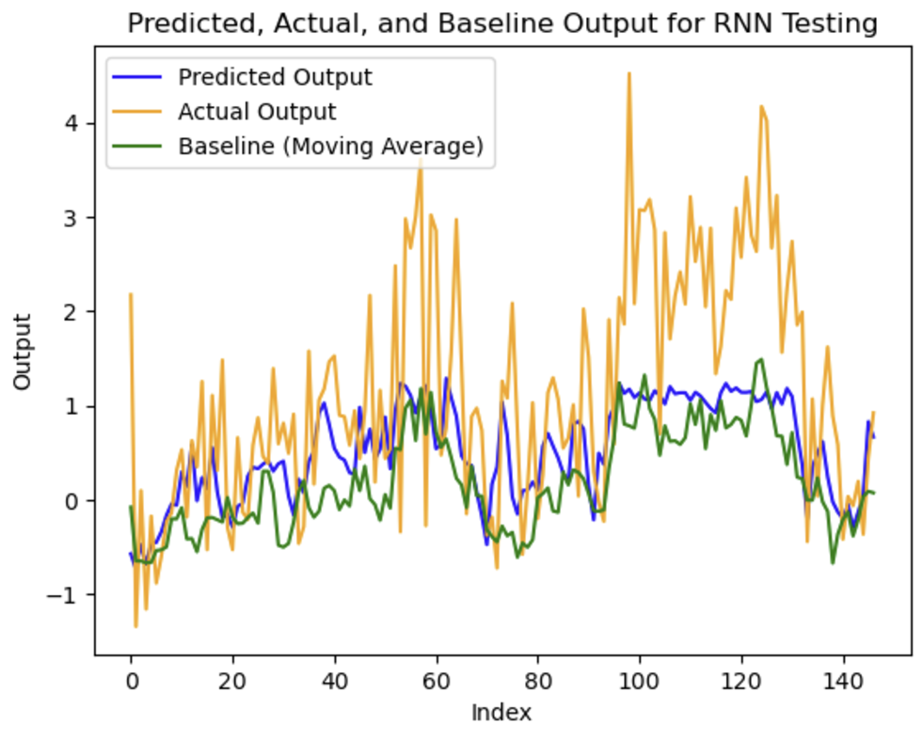
Final Results!
Future Plans:
Extend the output of the prediction to infer multiple prediction points simultaneously
Refine the final convolution to smooth the predicted time series
Train on a larger data set with more dynamic and unusual changes in network traffic
Fix overfitting issues while predicting on the test data
Final MAPE Improvement over Baseline: 202.95%

Slide 8
General Outline
Everett Tucker, First-year student, Computer Science Major
Problem Statement: This is part of a larger research project into designing a reinforcement learning agent to optimize communications between UAVs and ground users, such as pedestrians in an urban setting. In this scenario, the throughput of the user is hugely important, and predicting it more accurately in the future would improve our value function, and thus our model.
The data: I got the data from a Kaggle dataset that was originally designed for network anomaly detection, but it contains a lot of interesting communication metrics that I wanted to use for my project.

Slide 9
Preprocessing: This mostly involved scanning the data columns for useful features to use in my model, of which I found 5 good ones. I also looked over some of the non-numeric columns to determine if they had a significant impact on the general trends of the data. (I found that they didn’t really)
Inspection: I then plotted some lag plots of different features of the data to find out if there were any features that had really clear trends over time. I also used a linear regression model to check the independence of each of the features.
Data Transformations: I used principal component analysis to reduce the number of features from 5 to 2. This isn’t a huge benefit to the model training time, but it also helped to normalize the data.

Slide 10
Model Training: To predict this data, I wanted to use a Recurrent Neural Network where previous data points were fed into a buffer of size k. I wrote the class and the feed forward method from PyTorch, and then optimized the model with the hyperparameters of k, learning_rate, activation function, loss function, and iterations. I used a validation set to test for overfitting of the model after training, and a final test to evaluate the final performance of the model.
Maybe use a moving average buffer at the end to improve the results a little more. This is a good idea and also makes the results a little more uniform. This is good for the final prediction where I want it to be nice and stable, because the RL model relies on it.

